Slide 1




Python

Slide 2


Machine Learning - Polynomial Regression
Polynomial Regression
If your data points clearly will not fit a linear regression (a straight line through all data points), it might be ideal for polynomial regression.
Polynomial regression, like linear regression, uses the relationship between the variables x and y to find the best way to draw a line through the data points.

Slide 3
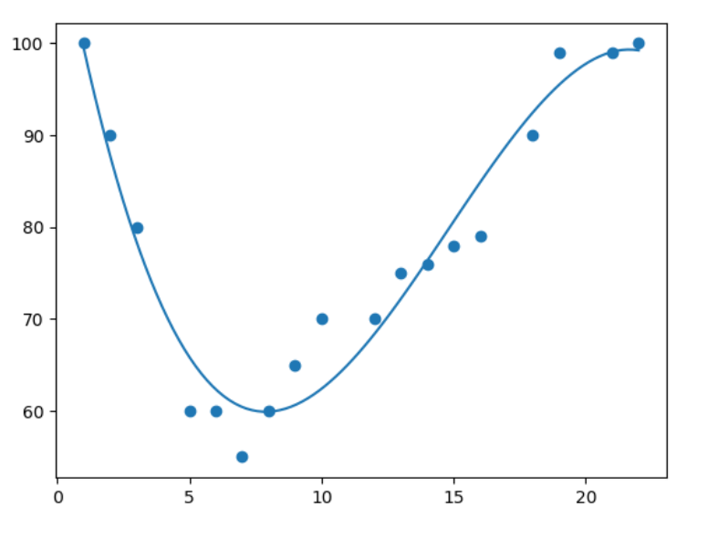
Machine Learning - Polynomial Regression

Slide 4
Machine Learning - Polynomial Regression
How Does it Work?
Python has methods for finding a relationship between data-points and to draw a line of polynomial regression. We will show you how to use these methods instead of going through the mathematic formula.
In the example below, we have registered 18 cars as they were passing a certain tollbooth.
We have registered the car's speed, and the time of day (hour) the passing occurred.
The x-axis represents the hours of the day and the y-axis represents the speed:

Slide 5
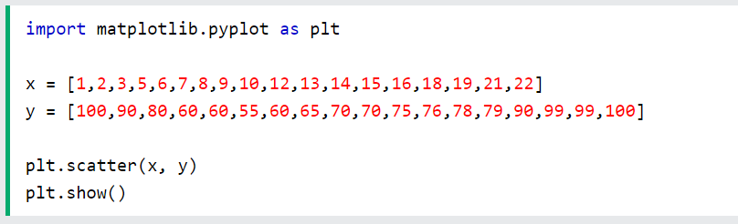
Machine Learning - Polynomial Regression
Example
Start by drawing a scatter plot:

Slide 6
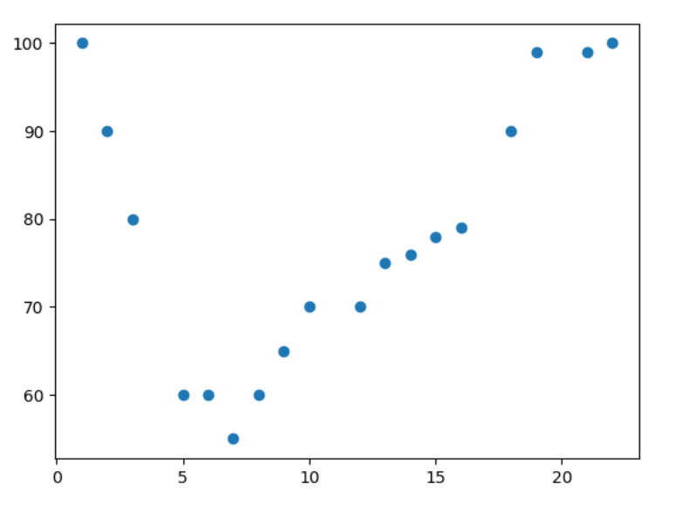
Machine Learning - Polynomial Regression
Result:

Slide 7
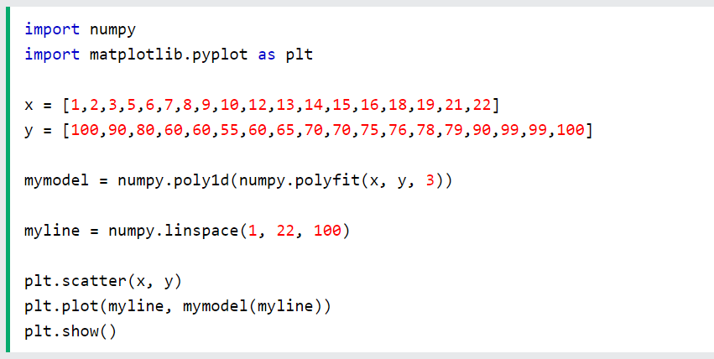
Machine Learning - Polynomial Regression
Example
Import numpy and matplotlib then draw the line of Polynomial Regression:

Slide 8
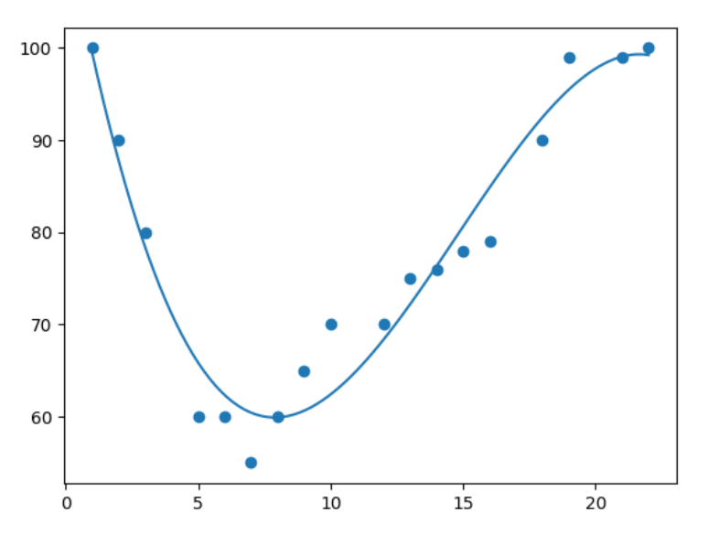
Machine Learning - Polynomial Regression
Result:

Slide 9
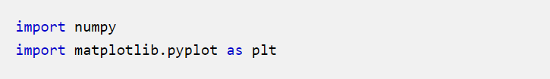
Machine Learning - Polynomial Regression
Example Explained
Import the modules you need.
You can learn about the NumPy module in our NumPy Tutorial.
You can learn about the SciPy module in our SciPy Tutorial.

Slide 10
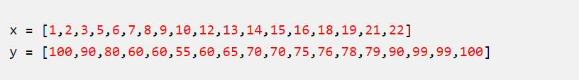

Machine Learning - Polynomial Regression
Create the arrays that represent the values of the x and y axis:
NumPy has a method that lets us make a polynomial model:

Slide 11
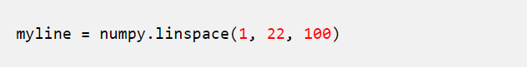
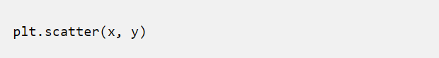
Machine Learning - Data Distribution
Then specify how the line will display, we start at position 1, and end at position 22:
Draw the original scatter plot:

Slide 12
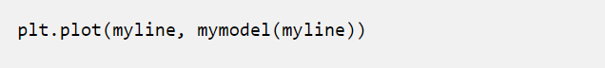
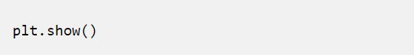
Machine Learning - Polynomial Regression
Draw the line of polynomial regression:
Display the diagram:

Slide 13
Machine Learning - Data Distribution
R-Squared
It is important to know how well the relationship between the values of the x- and y-axis is, if there are no relationship the polynomial regression can not be used to predict anything.
The relationship is measured with a value called the r-squared.
The r-squared value ranges from 0 to 1, where 0 means no relationship, and 1 means 100% related.
Python and the Sklearn module will compute this value for you, all you have to do is feed it with the x and y arrays:

Slide 14
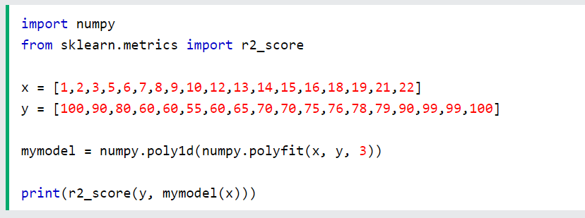
Machine Learning - Polynomial Regression
Example
How well does my data fit in a polynomial regression?

Slide 15
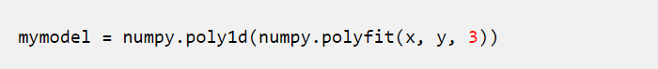
Machine Learning - Polynomial Regression
Predict Future Values
Now we can use the information we have gathered to predict future values.
Example: Let us try to predict the speed of a car that passes the tollbooth at around 17 P.M:
To do so, we need the same mymodel array from the example above:

Slide 16
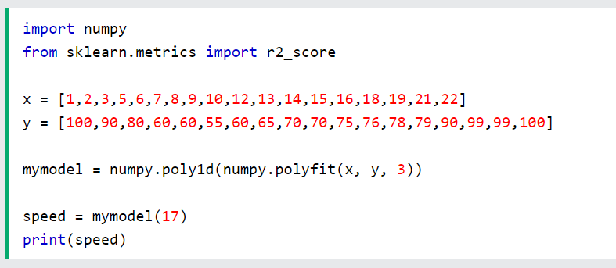
Machine Learning - Data Distribution
Example
Predict the speed of a car passing at 17 P.M:

Slide 17
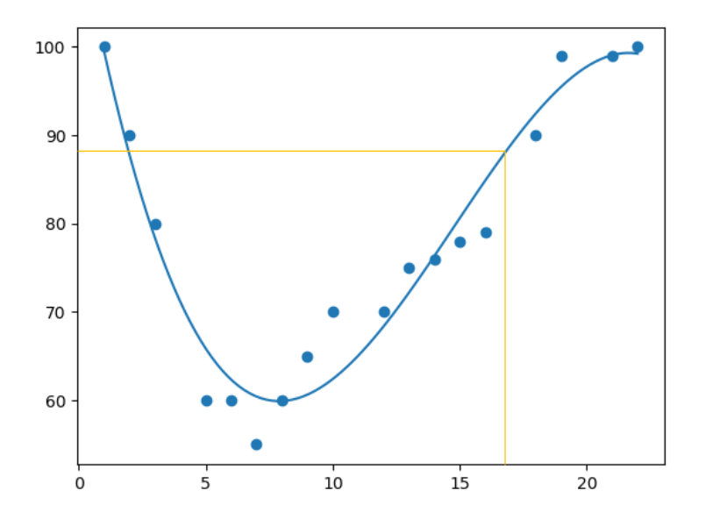
Machine Learning - Polynomial Regression
The example predicted a speed to be 88.87, which we also could read from the diagram:

Slide 18
Machine Learning - Polynomial Regression
Bad Fit?
Let us create an example where polynomial regression would not be the best method to predict future values.
Example
These values for the x- and y-axis should result in a very bad fit for polynomial regression:

Slide 19
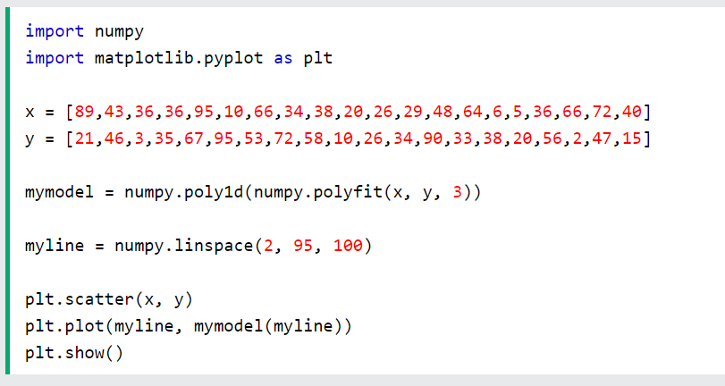
Machine Learning - Polynomial Regression

Slide 20
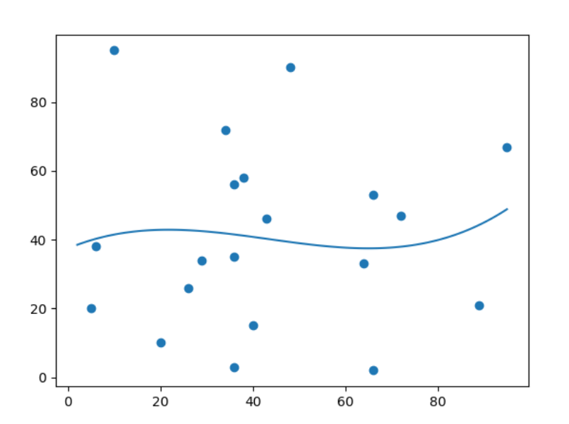
Machine Learning - Polynomial Regression
Result:

Slide 21
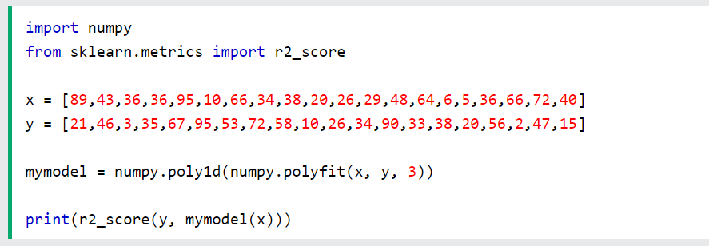
Machine Learning - Data Distribution
Machine Learning - Polynomial Regression

Slide 22
Machine Learning - Multiple Regression
Multiple Regression
Multiple regression is like linear regression, but with more than one independent value, meaning that we try to predict a value based on two or more variables.
Take a look at the data set below, it contains some information about cars.

Slide 23
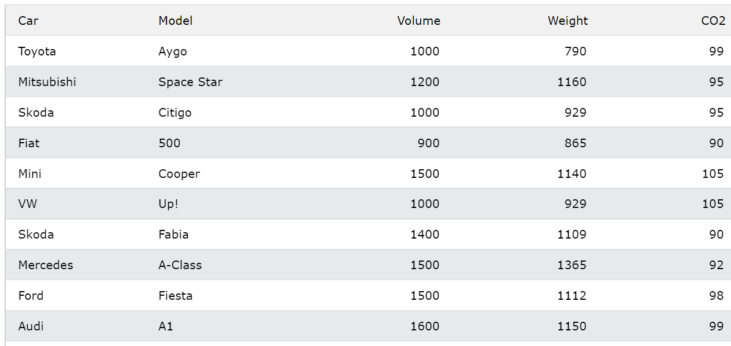
Machine Learning - Multiple Regression

Slide 24
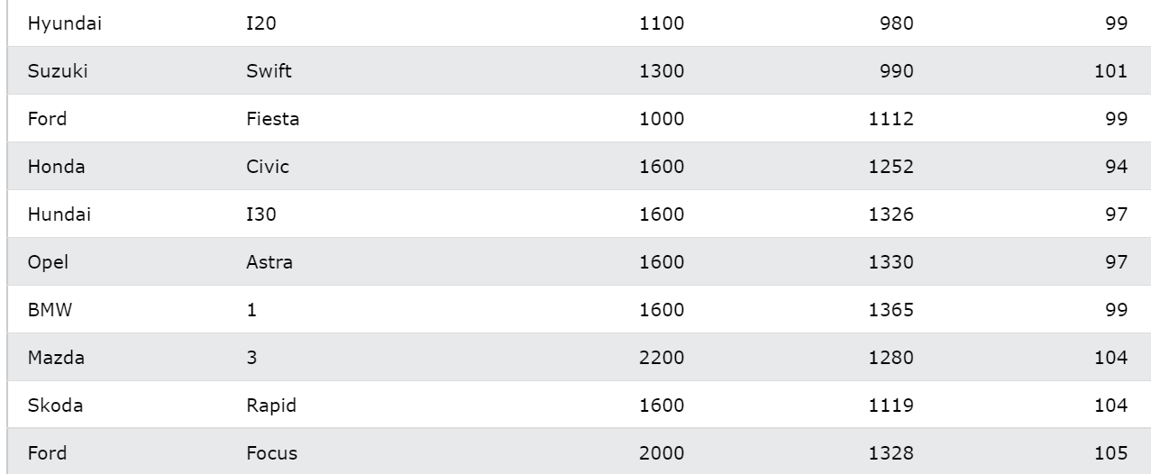
Machine Learning - Multiple Regression

Slide 25
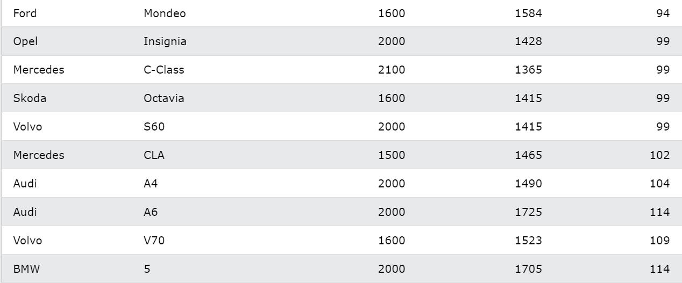
Machine Learning - Multiple Regression

Slide 26
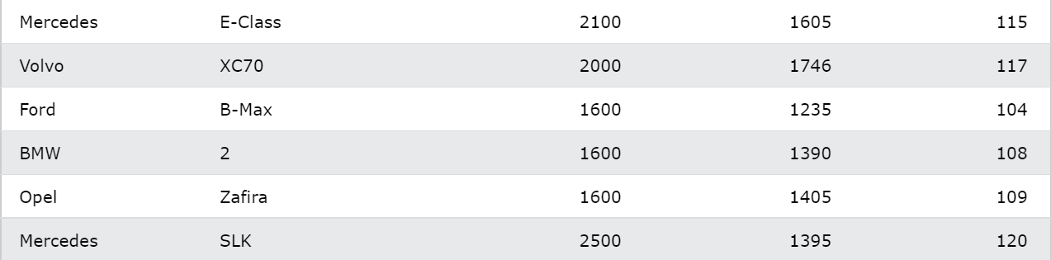
Machine Learning - Multiple Regression

Slide 27
Machine Learning - Multiple Regression
We can predict the CO2 emission of a car based on the size of the engine, but with multiple regression we can throw in more variables, like the weight of the car, to make the prediction more accurate.
How Does it Work?
In Python we have modules that will do the work for us. Start by importing the Pandas module.

Slide 28
Machine Learning - Multiple Regression
Learn about the Pandas module in our Pandas Tutorial.
The Pandas module allows us to read csv files and return a DataFrame object.
The file is meant for testing purposes only, you can download it here: cars.csv

Slide 29
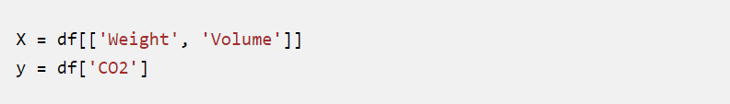
Machine Learning - Multiple Regression
Then make a list of the independent values and call this variable X.
Put the dependent values in a variable called y.
Tip: It is common to name the list of independent values with a upper case X, and the list of dependent values with a lower case y.

Slide 30
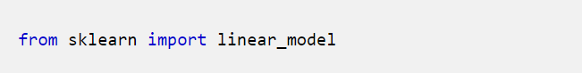
Machine Learning - Multiple Regression
We will use some methods from the sklearn module, so we will have to import that module as well:
From the sklearn module we will use the LinearRegression() method to create a linear regression object.

Slide 31
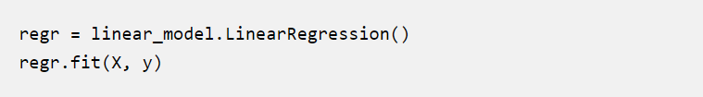
Machine Learning - Multiple Regression
This object has a method called fit() that takes the independent and dependent values as parameters and fills the regression object with data that describes the relationship:

Slide 32
Machine Learning - Multiple Regression
Now we have a regression object that are ready to predict CO2 values based on a car's weight and volume:
Example
See the whole example in action:
Continue…

Slide 33
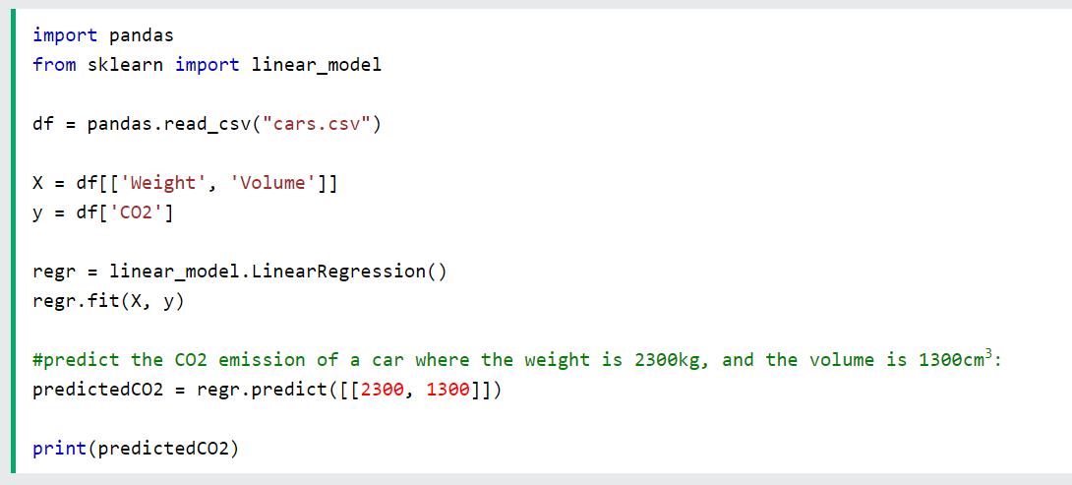
Machine Learning - Multiple Regression

Slide 34
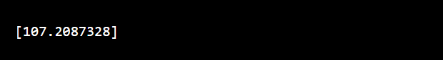
Machine Learning - Multiple Regression
Result:
We have predicted that a car with 1.3 liter engine, and a weight of 2300 kg, will release approximately 107 grams of CO2 for every kilometer it drives.

Slide 35
Machine Learning - Multiple Regression
Coefficient
The coefficient is a factor that describes the relationship with an unknown variable.
Example: if x is a variable, then 2x is x two times. x is the unknown variable, and the number 2 is the coefficient.
In this case, we can ask for the coefficient value of weight against CO2, and for volume against CO2. The answer(s) we get tells us what would happen if we increase, or decrease, one of the independent values.

Slide 36
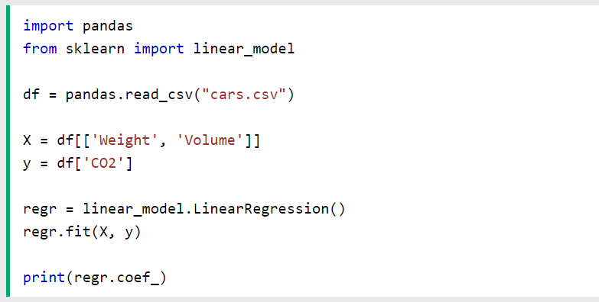
Machine Learning - Multiple Regression
Example
Print the coefficient values of the regression object:

Slide 37
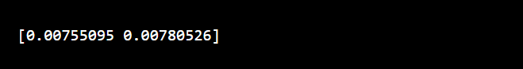
Machine Learning - Multiple Regression
Result:
Result Explained
The result array represents the coefficient values of weight and volume.
Weight: 0.00755095
Volume: 0.00780526
Continue…

Slide 38
Machine Learning - Multiple Regression
These values tell us that if the weight increase by 1kg, the CO2 emission increases by 0.00755095g.
And if the engine size (Volume) increases by 1 cm3, the CO2 emission increases by 0.00780526 g.
I think that is a fair guess, but let test it!
We have already predicted that if a car with a 1300cm3 engine weighs 2300kg, the CO2 emission will be approximately 107g.

Slide 39
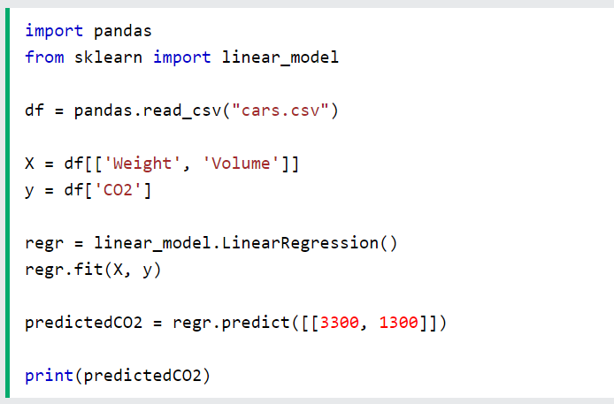
Machine Learning - Multiple Regression
What if we increase the weight with 1000kg?
Example
Copy the example from before, but change the weight from 2300 to 3300:

Slide 40
Machine Learning - Scale
Scale Features
When your data has different values, and even different measurement units, it can be difficult to compare them. What is kilograms compared to meters? Or altitude compared to time?
The answer to this problem is scaling. We can scale data into new values that are easier to compare.
Take a look at the table below, it is the same data set that we used in the multiple regression chapter, but this time the volume column contains values in liters instead of cm3 (1.0 instead of 1000).

Slide 41
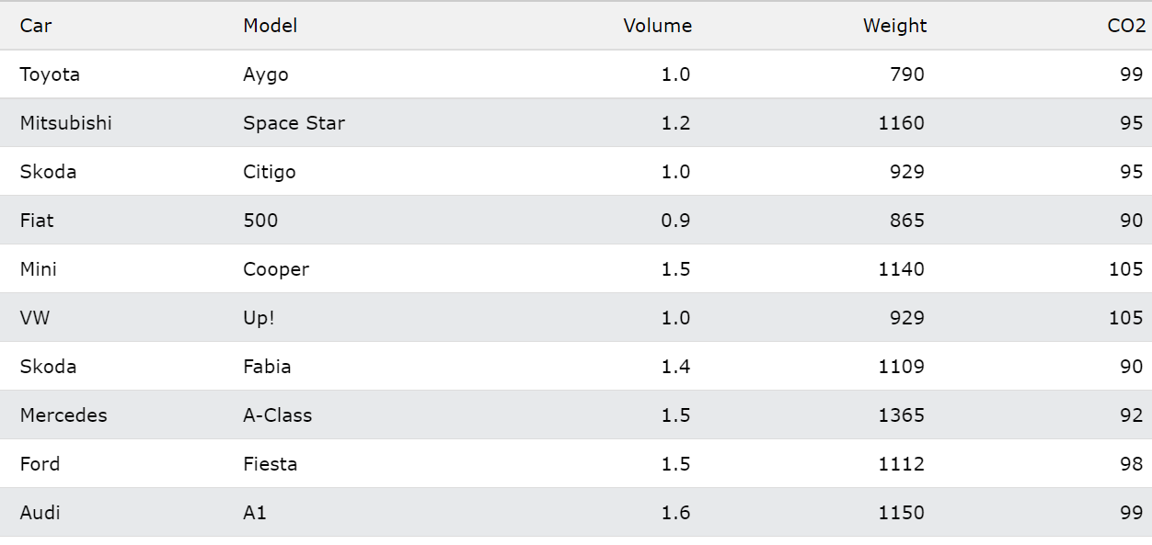
Machine Learning - Scale

Slide 42
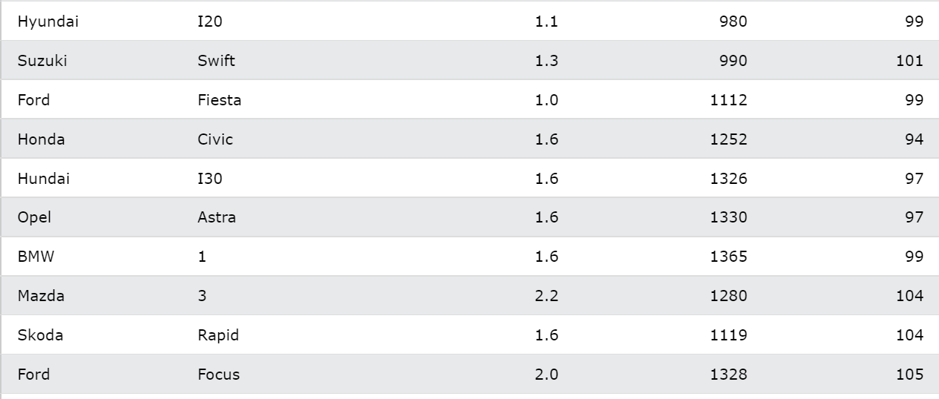
Machine Learning - Scale

Slide 43
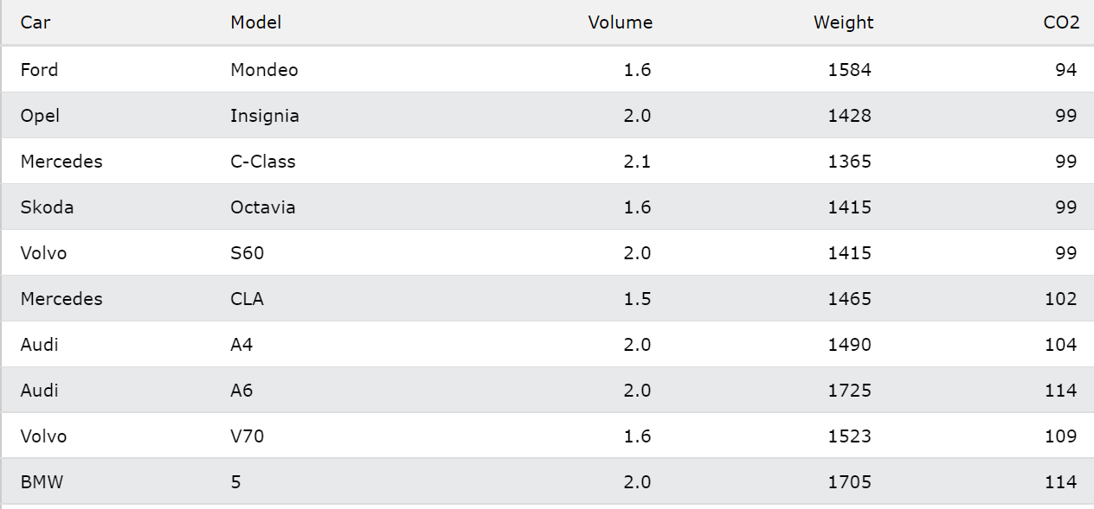
Machine Learning - Scale

Slide 44
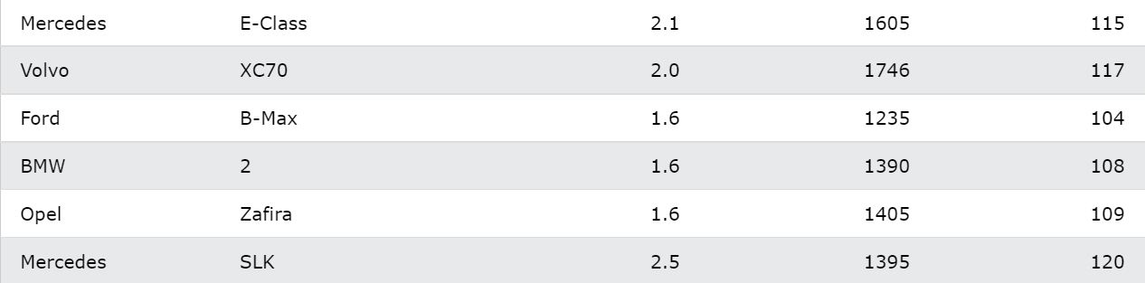
Machine Learning - Scale

Slide 45
Machine Learning - Scale
It can be difficult to compare the volume 1.0 with the weight 790, but if we scale them both into comparable values, we can easily see how much one value is compared to the other.
There are different methods for scaling data, in this tutorial we will use a method called standardization.
The standardization method uses this formula:
z = (x - u) / s
Where z is the new value, x is the original value, u is the mean and s is the standard deviation.

Slide 46
Machine Learning - Scale
If you take the weight column from the data set above, the first value is 790, and the scaled value will be:
(790 - 1292.23) / 238.74 = -2.1
If you take the volume column from the data set above, the first value is 1.0, and the scaled value will be:
(1.0 - 1.61) / 0.38 = -1.59
Now you can compare -2.1 with -1.59 instead of comparing 790 with 1.0.
You do not have to do this manually, the Python sklearn module has a method called StandardScaler() which returns a Scaler object with methods for transforming data sets.

Slide 47
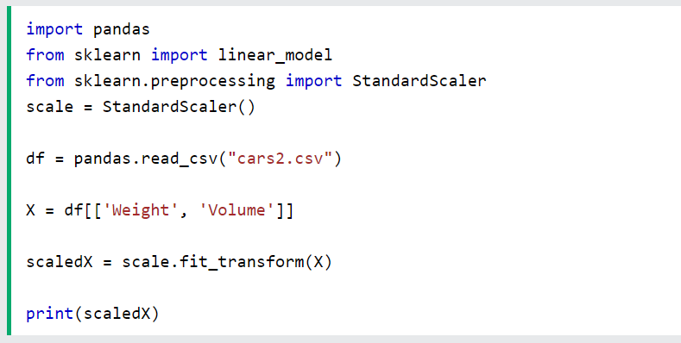
Machine Learning - Scale
Example
Scale all values in the Weight and Volume columns:

Slide 48
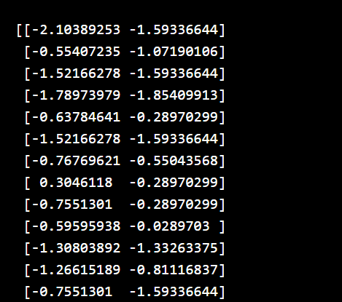
Machine Learning - Scale
Result:
Note that the first two values are -2.1 and -1.59, which corresponds to our calculations:

Slide 49
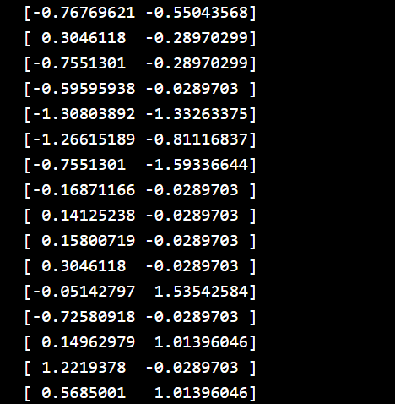
Machine Learning - Scale

Slide 50
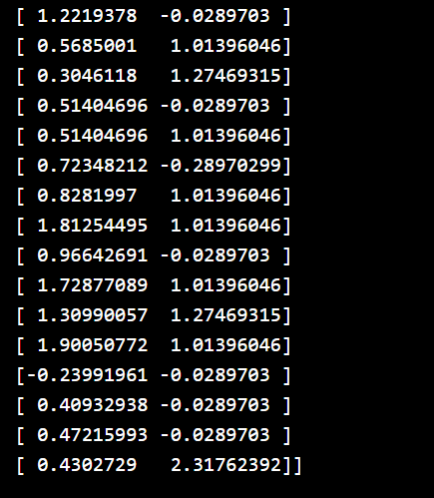
Machine Learning - Scale

Slide 51
Machine Learning - Scale
Predict CO2 Values
The task in the Multiple Regression chapter was to predict the CO2 emission from a car when you only knew its weight and volume.
When the data set is scaled, you will have to use the scale when you predict values:

Slide 52
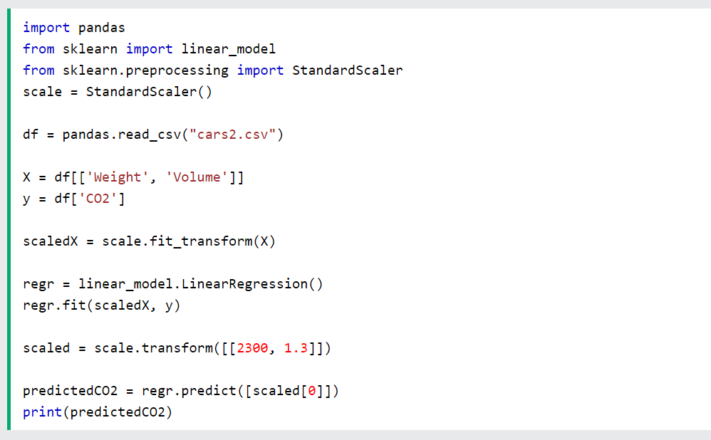
Machine Learning - Scale
Example
Predict the CO2 emission from a 1.3 liter car that weighs 2300 kilograms:

